Slide 1
Lesson One
Create MVC Web Application
Dragos Rosca
Automatica si Calculatoare 2018

Slide 2
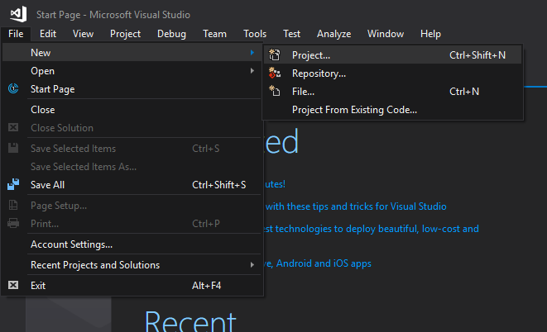
Create Project
Open File menu
Choose New
Click Project…
Or use the shortcut
Ctrl + Shift + N
This requires that your environment settings are set to C# developer

Slide 3
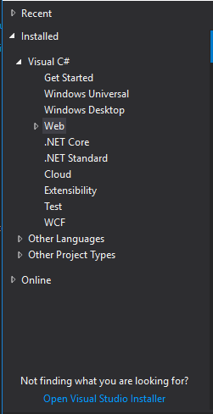
Create Project
On the left menu, expand:
Installed
Visual C#
Web

Slide 4
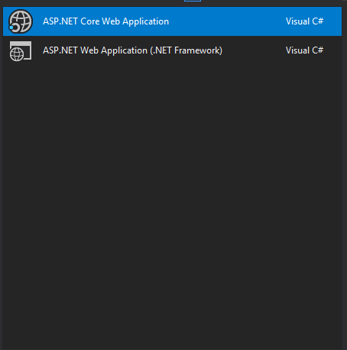
Create Project
On the middle part select
ASP.NET Core Web Application

Slide 5
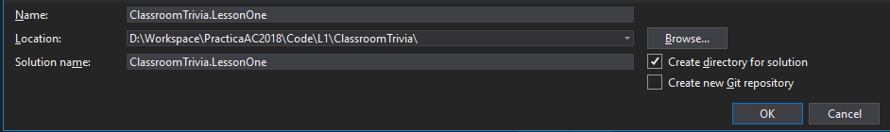
Create Project
On the bottom please name your application and choose a location

Slide 6
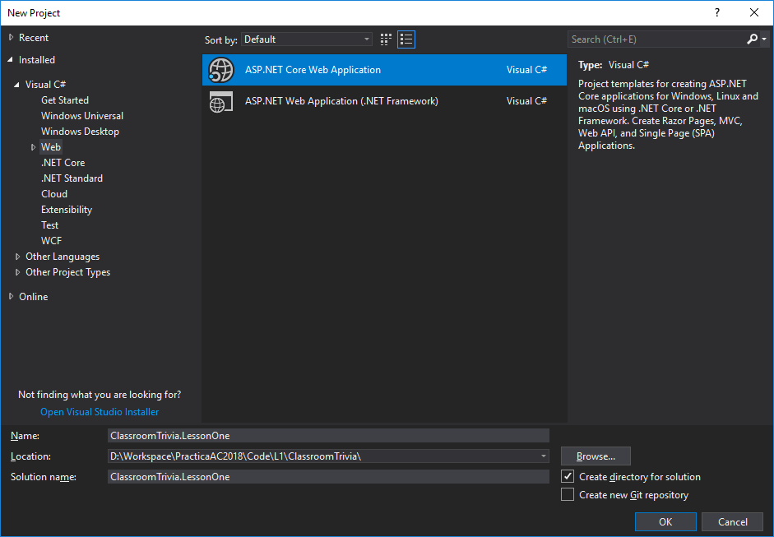
Create Project
Click OK

Slide 7
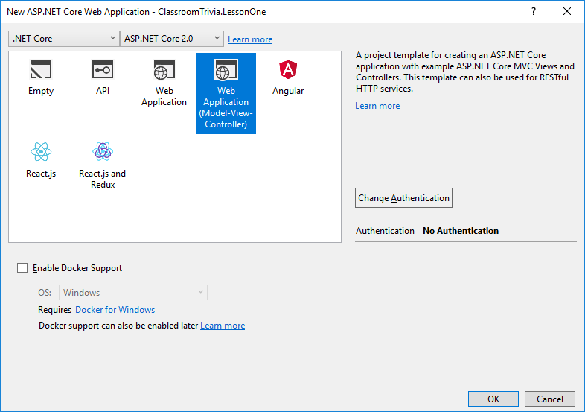
Create Project
On the next window choose “Web Application (Model-View-Controller)”
Click OK

Slide 8
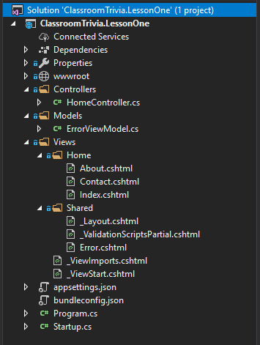
Create Project
At this point your Solution Explorer window should look like this
You should be able to build and run the solution

Slide 9
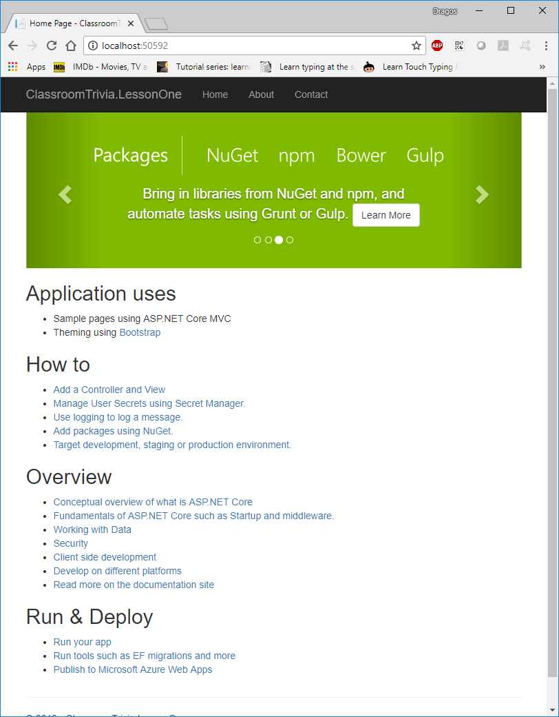
Create Project
Running the solution should open a browser looking something like this

Slide 10
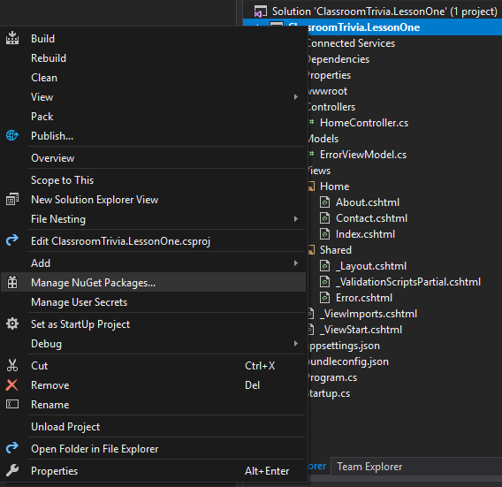
Adding Dependencies
Before adding the controller we need to prepare some dependencies.
Right click your project
Choose “Manage NuGet Packages…”

Slide 11
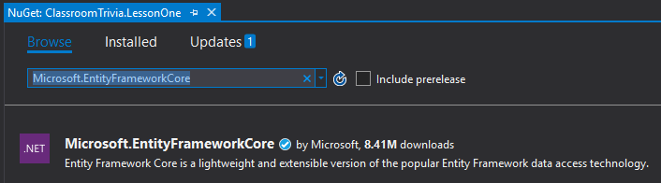
Adding Dependencies
On the NuGet page click the Browse menu
Type in the search bar “Microsoft.EntityFrameworkCore”

Slide 12
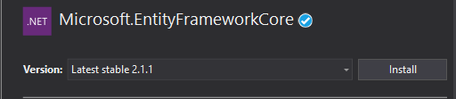
Adding Dependencies
Select Microsoft.EntityFrameworkCore
Click Install
Scroll down and select Microsoft.EntityFrameworkCore.SqlServer

Slide 13
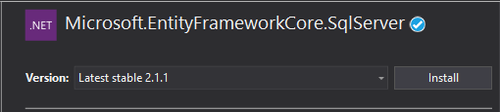
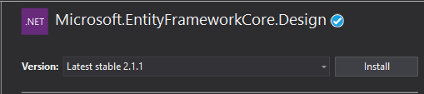
Adding Dependencies
Click Install
Select Microsoft.EntityFrameworkCore.Design
Click Install

Slide 14
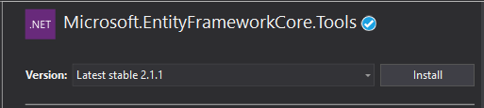
Adding Dependencies
Select Microsoft.EntityFrameworkCore.Tools
Click Install

Slide 15
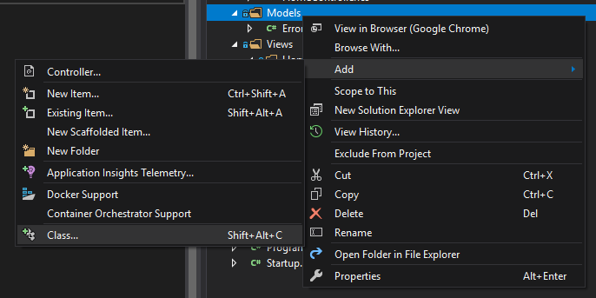
Adding Model Class
Right click on the Models folder
Select Add
Click Class…

Slide 16
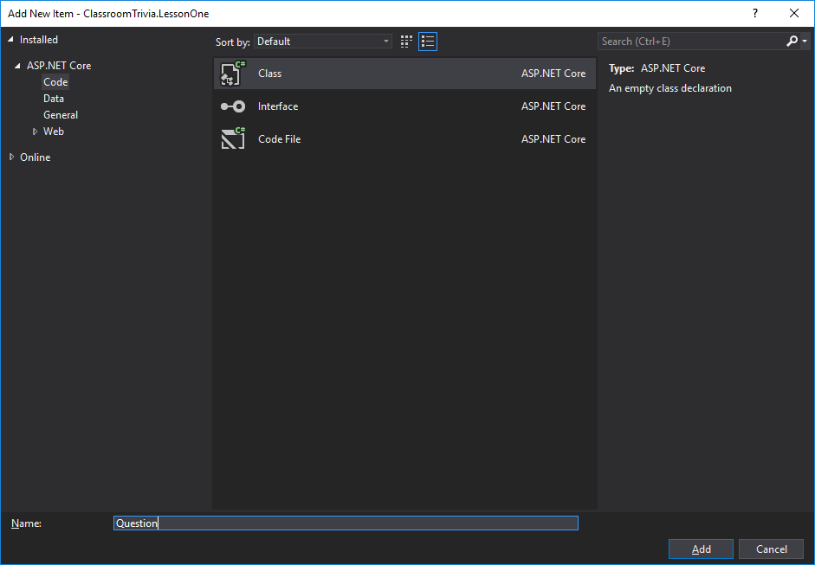
Adding Model Class
On the Add New Item window type in the name of the class (Question) and click Add

Slide 17
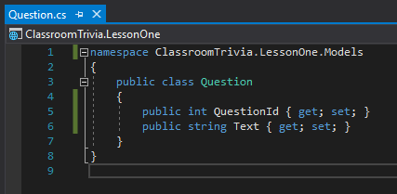
Adding Model Class
In the Question class add two new properties
namespace ClassroomTrivia.LessonOne.Models
{
public class Question
{
public int QuestionId { get; set; }
public string Text { get; set; }
}
}

Slide 18
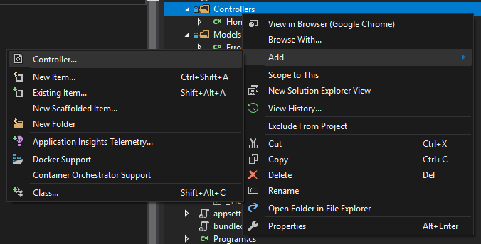
Adding Controller
Right click on the Controllers folder
Select Add
Click Controller…

Slide 19
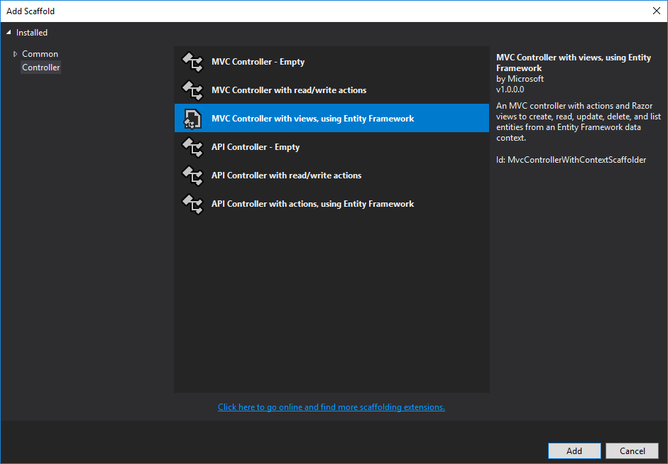
Adding Controller
On the Add Scaffold window select “MVC Controller with views, using Entity Framework”
Click Add

Slide 20
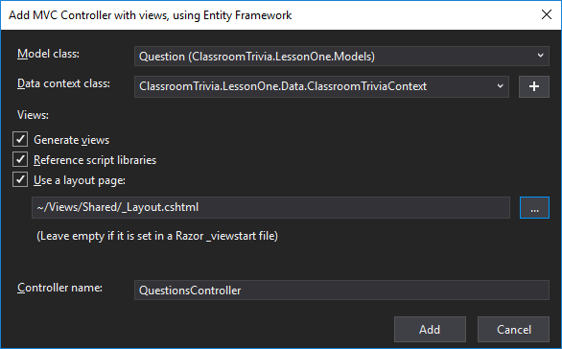
Adding Controller
Model class:
Select the Question class
Data context class:
Click the + button
Change the name to
“ClassroomTrivia.LessonOne.Data.ClassroomTriviaContext”
Controller name:
QuestionsController

